Slide 1

REPLACE- Analysis of Circular Economy (CE) Capabilities in the Region of Crete (RoC)
Dr Maria Kandilogiannaki,
Directorate of Environment & Spatial Planning, RoC
Heraklion, 8 October 2021

Slide 2

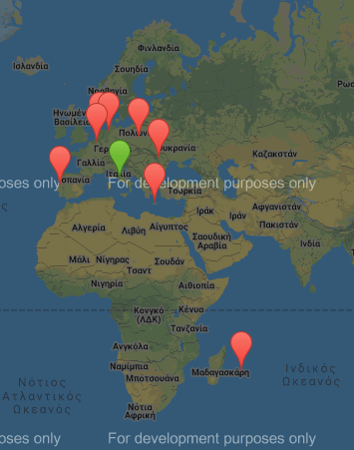
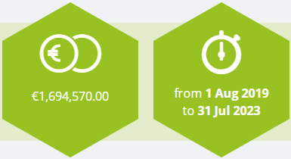
REPLACE: REgional PoLicy Actions for Circular Economy
Περιφερειακές δράσεις πολιτικής για την κυκλική οικονομία
Project Partners (9)
Lazio Region (IT)
Veltha ivzw (BE)
Hamburg Institute of International Economics (DE)
Crete Region (EL)
Nexa - regional agency for investment development and innovation (FR)
Province of Fryslân (NL)
Lodzkie Region (PL)
Centro Region commission for coordination and development (PT)
North-East Regional Development Agency (RO)

Slide 3

REPLACE: REgional PoLicy Actions for Circular Economy
Περιφερειακές δράσεις πολιτικής για την κυκλική οικονομία
REPLACE aims at enhancing the transition towards a CE by influencing the regional policy instruments: the main operative target refers to the development and implementation of policies and actions focusing on identification, valorization, assessment and financing of circular value chains, resulting in new local and interregional projects.
Local Analysis: to identify regional CE potential
Cross-regional synergies: to combine regional capabilities and enhance
collaboration
Funding Tools: to finance the CE transition
Assessment Criteria: to evaluate CE proposals

Slide 4
Analysis of CE Capabilities in the RoC-Local Analysis Scope
Identify specific value chains in agreement with RIS3 CRETE
Cross-regional Collaboration to stimulate transition towards CE by funding related projects
Mapping of the existing emerging ideas-capabilities/education-best practices being developed in the Region of Crete (based on Deliverable D2.1 of SCREEN program)

Slide 5
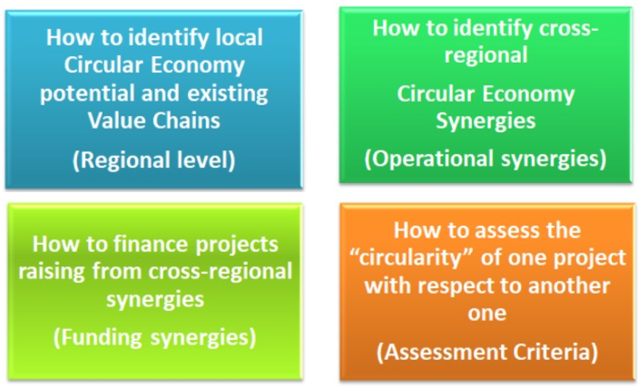
SCREEN: Synergic CirculaR Economy across European regioNs
Horizon 2020 project
Ancestor of REPLACE
4-step bottom-up approach based on a continuous consultation among its 17 Regions.

Slide 6
Analysis of CE Capabilities in the RoC-Local Analysis Methodology
Database (Bibliographic search-Previous experience) of:
  Organizations of the triple helix focusing on CE
    Research institutes and universities,
    Public bodies,
    Private sector
  Respective projects, applications and pilot infrastructures
Interviews:
  Stakeholders
  Use of a specially designed questionnaire
Completion of Screen Tool
Analysis of the above data for the extraction of results and conclusions
INTERVIEW PERIOD
June-September 2020
This research prepared a record, upon:
R&D Initiatives including CE fundamentals in at least one stage of planning
Educational Community including CE either in their courses, or in their research activities
Innovation capabilities, developing CE criteria
Emerging ideas, that lead to projects based on CE

Slide 7
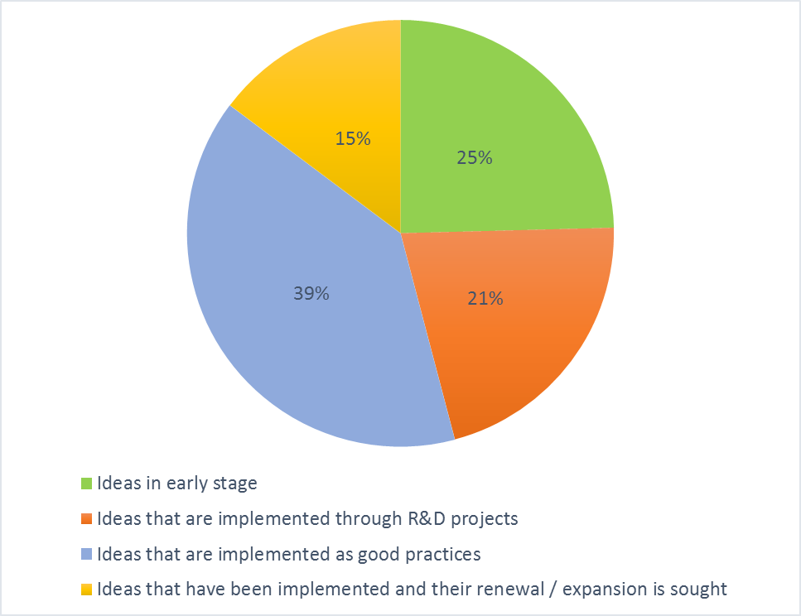
Analysis of CE Capabilities in the RoC-Local Analysis Results
46 interviews & 61 emerging ideas
Distribution of emerging ideas based on their stage / evolution
Distribution of emerging ideas based on the responsible body
49% Universities-Research Institutes
35% Private sector
16% Public sector

Slide 8
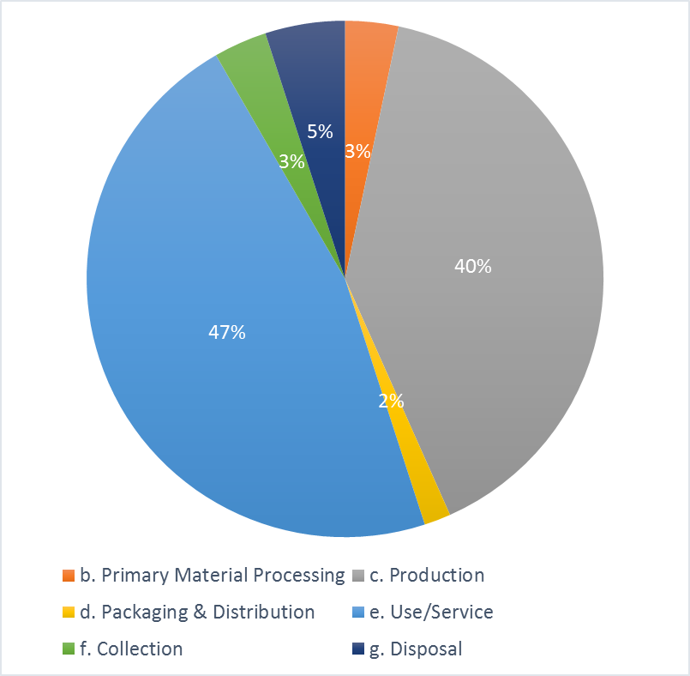
Analysis of CE Capabilities in the RoC-Local Analysis Results
Distribution of emerging ideas based on the value chain
86.7% of the emerging ideas are shared between the production and the provision of use / Services.

Slide 9
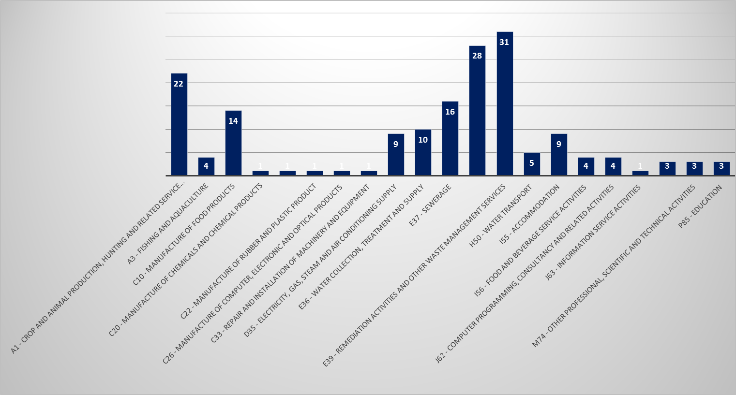
Analysis of CE Capabilities in the RoC-Local Analysis Results
Number of ideas per Target - Sector
Target-Sector with the majority of emerging ideas
E38 - Waste collection, treatment and disposal activities; materials recovery,
E39 - Remediation activities and other waste management services
A1 - Crop and animal production, hunting and related service activities.
E37 – Sewerage
C10 – Manufacture of food products
Notice: Each idea can be related to more than one target area.

Slide 10
Analysis of CE Capabilities in the RoC-Local Analysis Results
Distribution of emerging ideas based both on target sector and their stage/evolution
Categorization included the most active target sectors with a higher number of emerging ideas

Slide 11
Analysis of CE Capabilities in the RoC-Local Analysis Results
Distribution of CE related projects by source of funding
EU Financing Tools
35% INTERREG
12% HORIZON
16% LIFE
16% NSRF (Sectoral & Regional)
Total funding of 144.93 million euros
A total of 49 CE projects were recorded.
RoC is involved in 13 CE projects

Slide 12
Analysis of CE Capabilities in the RoC-Local Analysis Results
CE related Research and Educational Infrastructure in RoC
Number of researchers working in the field of CE per university/research institute

Slide 13
Analysis of CE Capabilities in the RoC-Local Analysis Results
CE related Research and Educational Infrastructure in RoC
CE related courses per Educational Institute
University/Institute | Number of courses (undergraduate, postgraduate, seminar, doctoral) | Rate
University of Crete | 5 | 20.8%
Hellenic Mediterranean University | 3 | 12.5%
Technical University of Crete | 12 | 50.0%
Mediterranean Agronomic Institute of Chania | 3 | 12.5%
Center for adults education – Technical schools – Chamber of Herakleion | 1 | 4.2%
Total | 24 | 100%

Slide 14
Analysis of CE Capabilities in the RoC-Local Analysis Results
CE related Research and Educational Infrastructure in RoC
Number of students trained in CE related topics per educational institute
University of Crete
Department of Biology
Department of of Materials Science and Technology
TUC
Department of Environmental
Engineering
Hellenic Med. University
Department of Agriculture

Slide 15
Analysis of CE Capabilities in the RoC-Local Analysis Results
CE related Research and Educational Infrastructure in RoC
Courses Levels
Courses and participants – Example TUC

Slide 16
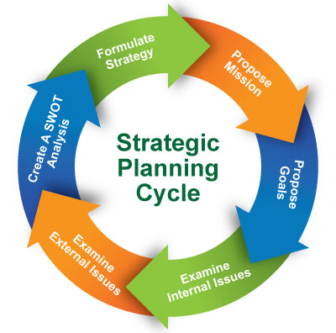
Analysis of CE Capabilities in the RoC-Local Analysis
Conclusions-Next steps
Most active sectors including CE fundamentals
Waste collection, treatment and disposal activities
Remediation activities and other waste management services
Crop- Animal production and related service activities eg manufacture of food products.
The number of researchers and students involved in CE related topics, reveals a strong academic and research profile which needs to establish cooperation channels with the private sector (mainly SMEs with limited innovation culture while Industrial sector remains underdeveloped).
NEXT STEPS
Transition towards CE to reduce the environmental footprint of production activities has been included as a Horizontal Principle to the issued RoC Strategic Plan 2020-2023.

Slide 17
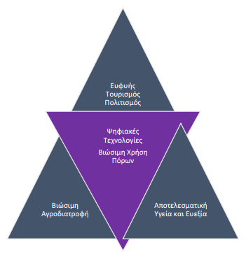
Analysis of CE Capabilities in the RoC-Local Analysis
Conclusions-Next steps
RoC RIS3 Smart Specialization strategy 2021-2027 has been revised (July 2021) and included CE transition principle in the following areas of specialization:
Sustainable Agronutrition
Sustainable Use of Resources
Revised RoC RIS3 2021-2027
In alignment with REPLACE Local Analysis, RoC RIS3 2021-2027 is focusing on
• Innovation development with emphasis on universities/research centers and business partnerships.
• Strengthen research infrastructures to support the areas of regional economy specialization.
• Undertake investments for the exploitation of the developed innovations (as products) or their integration into production procedures.
• Supporting business recovery by investing in new activities.

Slide 18
Thank you!

