Slide 1
Good practices for the use of olive by-products

Slide 2
Delights of Crete is a commercial alliance of four historical companies from Crete, that intend to promote Cretan products, beyond local and national borders.

Slide 3
Our vision is that products of Delights of Crete pass on the values of Cretan nutrition and become synonymous with quality Cretan products, that respect tradition and mankind.

Slide 4
Delights of Crete supports the agricultural production of Crete and to contributes to the competitiveness of local businesses.

Slide 5
Synergies
Research & Development of new products
Production
Sales-marketing
Logistics
Human resources

Slide 6
Benefits
Improving resource utilization
Production of innovative products
Energy saving
Economies of scale
Effective use of by-products
Carbon footprint improvement

Slide 7
Added value product development:
from olive processing by-products

Slide 8
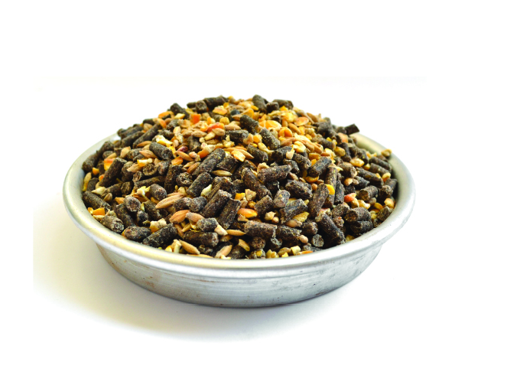
olive processing by-products
OLIVEOLEIC - OLIVE PULP
Oliveoleic is olive pulp for animal feed, rich in oleic acid, polyphenols, and vegetable fibers.
Adding the oil pulp to the feed can increase the level of Oleic Acid and Unsaturated Fatty Acids in animal products (meat, milk, eggs).
Olive pulp is a by-product of olive pomace oil production, obtained by solvent extraction and destoning of the crude olive oil cake. The crude olive oil cake obtained by extraction of pressed olives Olea europa L.

Slide 9
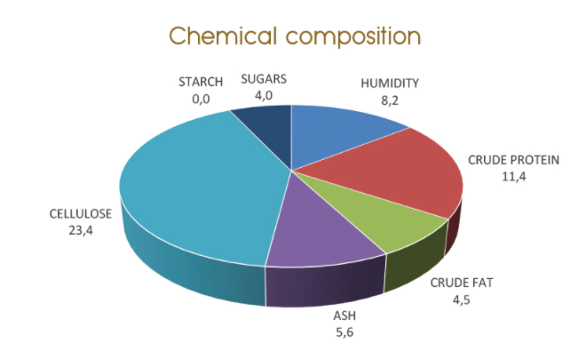
olive processing by-products
68,6% of the total fatty acids is Oleic Acid

Slide 10
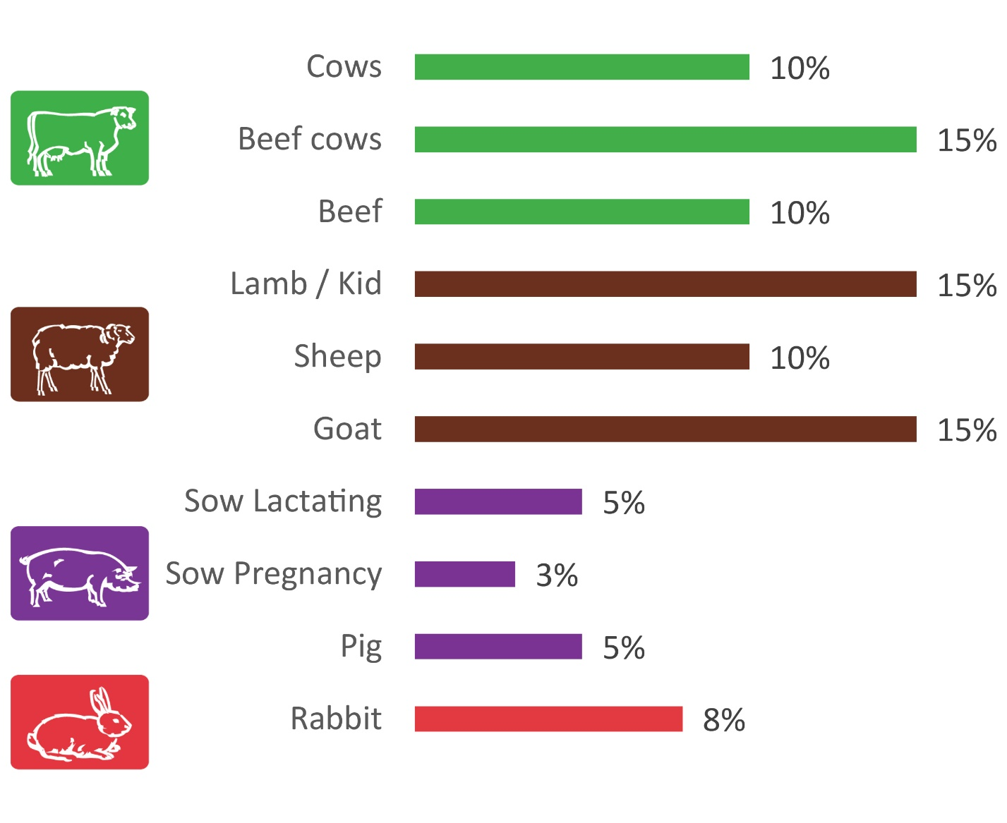
olive processing by-products
Oliveoleic is suitable for different categories of animals, and the higher recommended participation varies by category.

Slide 11
olive processing by-products
OLIVE BIOMASS
Olive Biomass is a new biofuel that responds to the demand for cheap and clean, domestic energy. The raw material used to produce it is the olive-pomace, which after a technically specialized treatment is cleaned to leave only the wood, giving an ecological biofuel with high thermal value, low ash and odor.

Slide 12
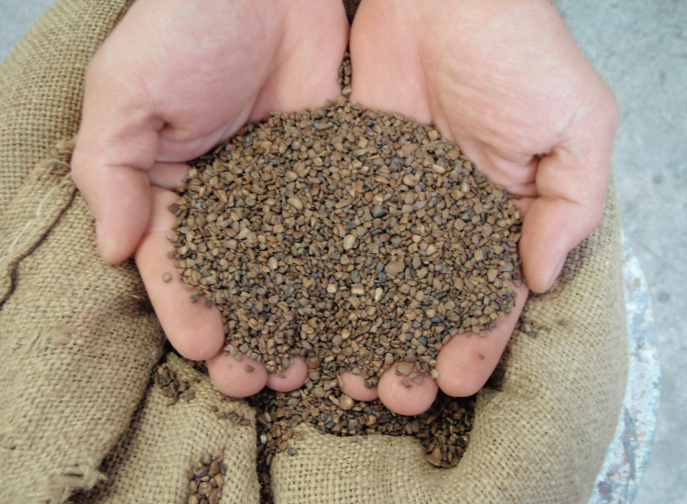
olive processing by-products
APPLICATIONS
Olive Biomass can be used from heating a house to producing energy for the industry. To use it, it is necessary to have burners or stoves of wood based fuel or poly-burners, suitable for solid biofuels. Installing a biomass burning system offers flexibility and can be depreciated over a short period of time, as Olive Biomass has a low cost.

Slide 13
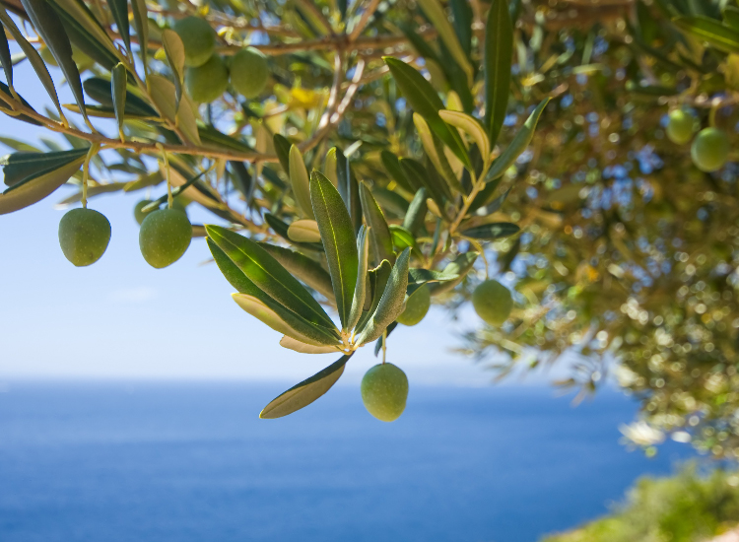
olive processing by-products
SUSTAINABILITY
Olive Biomass is an ecological, renewable source of energy, unlike oil and gas. The Ministry of the Environment has judged it to be preferable to oil and suitable for use in cities.
QUALITY
Olive Biomass is a high-quality product that offers clean combustion with low emissions of gases and odors. Olive Biomass has a constant quality, high thermal value (4,400 kcal / kg), low humidity (<10%), little smoke and low ash (0.5% -1%).

Slide 14
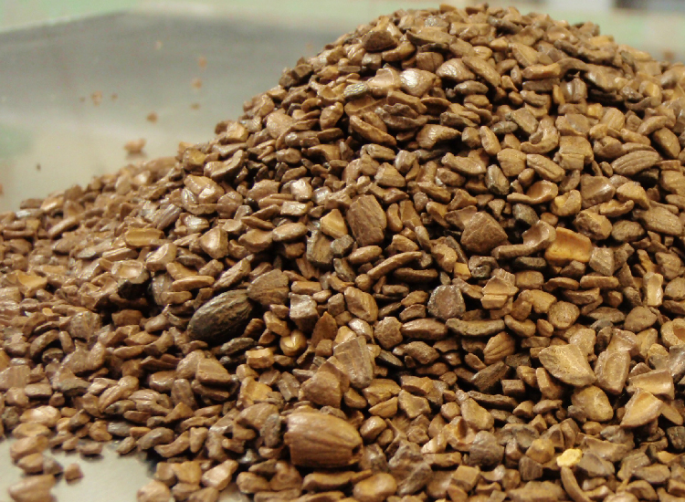
olive processing by-products
EASE
Olive Biomass is a handy form of energy. Compared to wood it occupies much less storage space. Continuous feeding from silo, unlike manual feed of wood or pomace. Supply can be made in small quantities, depending on the needs of the consumer.
ECONOMY
Olive Biomass offers maximum economy, which can reach 30% compared to wood pellets, or up to 55% compared to oil.

