Slide 1

Regional Policy Actions for Circular Economy
REPLACE the EU program on Circular Economy
Topic: Good Practices
Yiannis Charitakis

Slide 2
INTERREG EUROPE PROGRAMMS
Interreg EU Programs, help Regional & Local governments, develop & deliver better policy

Slide 3
REPLACE INTERREG EUROPE
Implementation & monitoring of Regional Policy Tools – Instruments at facilitating CE transition (Benchmark Tool)
Development and application of policies and actions focusing on identification, valorization, assessment and financing of circular value chains
Synergies Exploration within EU Regions
Financing strategy development for boosting CE transition
Regional Policy Actions for Circular Economy

Slide 4
GOOD PRACTICIES
Sustainable Production of Fabrics
  Country: Romania, Company: Majutex Value Chain: Manufacturing - Industry
REDU
  Country: Romania, Value Chain: Recycling Materials
Hamburg Bottle
  Country: Germany, Value Chain: Recycling
Circular & Wood construction in Hamburg
  Country: Germany, Value Chain: Construction
Centro Green Deal Project
  Country: Portugal, Value chain: Education
VCF: Circular Friesland Association
  Country: Netherlands, Value Chain: Education – Business cooperation
“Good Practice” are always important in developing or improving overall Strategies in CE

Slide 5

Sustainable Production of Fabrics - Majutex
Description: A fabrics – textile industry in Romania is developing a new production line, including New product produced of recycled material & driven by New technology machinery using renewable energy solutions
Budget: 1.858.350€
Potential for Learning or Transfer: Developing a green factory in textile sector represents a good asset at European level, were the need for developement to a more sustainable and eco-friendlier way of production is nowadays essential.

Slide 6

REDU
Description: A Romanian country level project, is promoting slow fashion, social economy and green entrepreneurship. In their 5 years of activity, they managed to collect approximately 10 tons of pre-consumer and post-consumer textiles which we managed to transform into 4689 up cycled new products - clothes, accessories and home items. Among these, they produced a number of 2104 products out of local textiles and ethical sources and extended the life cycle for over 3000 reused products that were sold in the cycle during this period.
Budget: Non profit initiative
Potential for Learning or Transfer: Extending the life cycle of products

Slide 7
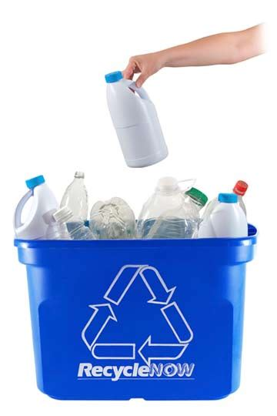
HAMBURG BOTTLE
Description: A project in Hamburg - Germany, focused in recycling plastic. This project brings together:
Stadtreinigung Hamburg: Gathering plastic waste
Veolia: Extracting HD Polyethylene from plastic waste
Unilever: Refills recycled bottles with detergent
Budni: Local Retailer for promoting this Product which carries recycled material packing
Resources Needed: Requires cooperation between Public & Private sector on several stages
Potential for Learning or Transfer: Closed Loops for certain products (e.x. plastic)

Slide 8

CIRCULAR & WOOD CONSTRUCTION IN HAMBURG
Description: This Good Practice emphasizes on CE in Constructions. First of all examines whether renovation is possible VS new building. If new construction is mandatory, sustainable material is preferred. Wood & RC – concrete are promoted. Actually 80cent/kg of wood selected in construction is subsidized by Public Sector.
Resources Needed: Financial resources to set – up subsidy, human capital for legislation reforming, info desk for network establishment
Potential for Learning or Transfer: Including recycled & low footprint material in large scale construction industry will improve prices & preserve competitiveness of these material in relevant market

Slide 9

CENTRO GREEN DEAL PROJECT
Description: Centro Green Deal Project, involves 13 entities (5 intermunicipal associations, 3 municipalities, 2 polytechnic schools, 1 university, 1 hospital & CCDRC) to promote CE through procurement. The level of engagement on CE between stakeholders is examined through this 1,5 year project. It was inspired from Dutch GD project and found support from Rijkswaterstaat, a national expert on procurement.
Resources Needed: Volunteer level program, although CCDR spent 15.000€ for administration expenses.
Potential for Learning or Transfer: Voluntary circular procurement networks in EU Regions

Slide 10

CIRCULAR FRIESLAND ASSOCIATION
Description: Involved Frisian companies who were looking support on knowledge, exchange, networking & collaboration level for cultivating CE transition. In VCF started in 2016 with almost 25 associated members and now includes more than 100.
Resources Needed: VCF is a non profit organisation.
Potential for Learning or Transfer: VCF is a great example of participative governance obtained through the cooperation among the Quadruple Helix actors that feeds not only in the governmental decision-making about CE, but also on the educational, research, civil society and business spheres.

Slide 11
Regional Policy Actions for Circular Economy
THANK YOU FOR YOUR KIND ATTENTION
Yiannis Charitakis

