Slide 1



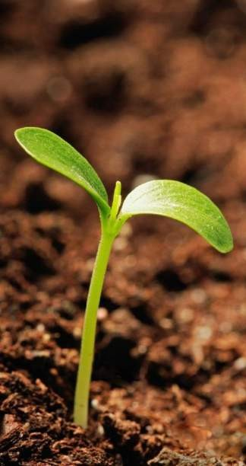

BIOENERGY CRETE SA
Biogas / Electricity / Organic Fertilizers / Biomethane
Ioannis Petrakakis
Biogas Plant Manager
October 2021

Slide 2
A “Green” Challenge for
Sychem Group
www.sychem.gr

Slide 3

The 3D Challenge – The key for sustainable development
DECARBONISATION
DECENTRALISATION
DIGITALISATION
Avoid CO2 or CH4 (GHG) emissions by using RES and energy integration techniques
To minimize the carbon footprint most of the water and energy systems must become local and decentralized
Decentralized units and efficient integration need advanced control methods and can be only viable though digitalization

Slide 4

Advantages of Biogas Plant
Green energy production from the biodegradation of organic waste
Solution to the organic waste management problem in a particularly environmentally- friendly way
Reduction of air, subsoil and water resources pollution due to the replacement of conventional power stations for energy production
Significant contribution to energy self-sufficiency of the country, replacing polluting or
imported fuels

Slide 5

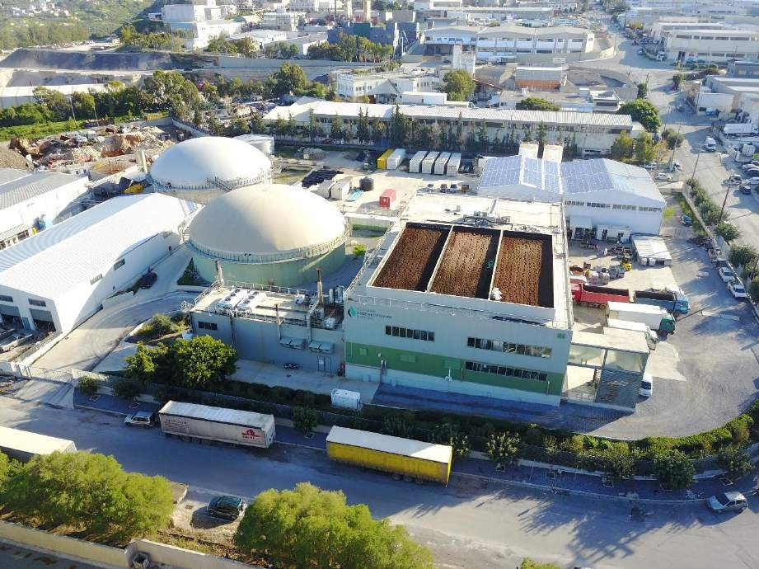
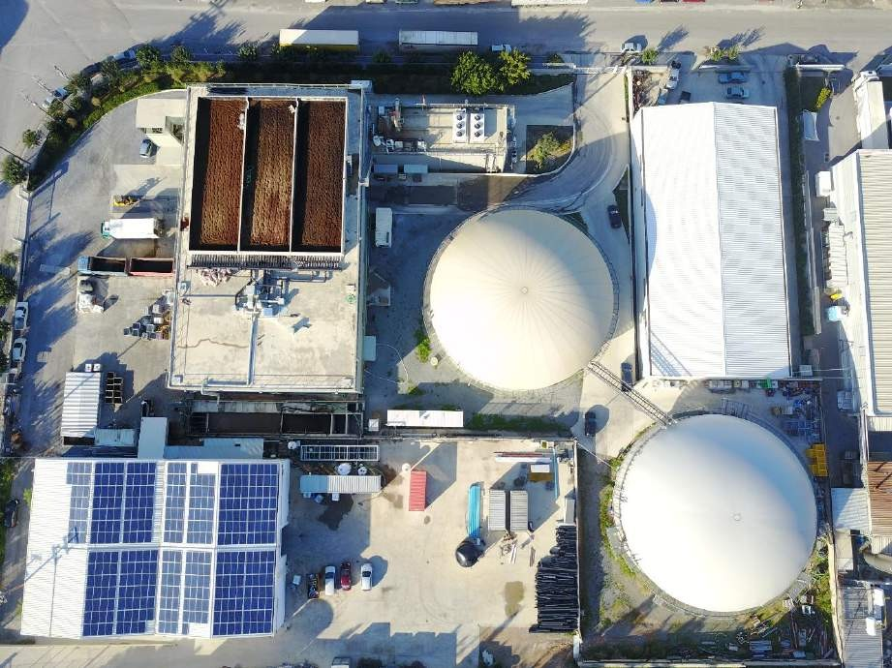

Slide 6
Raw Materials
Expired food from super markets
Poultry and pig
manure
Whey
Oils and Fats
Organic Waste (leftovers) from restaurants and hotels
Oil-mills organic
residue
Slaughterhouse
waste
Butcher shop
waste
Fish leftovers

Slide 7
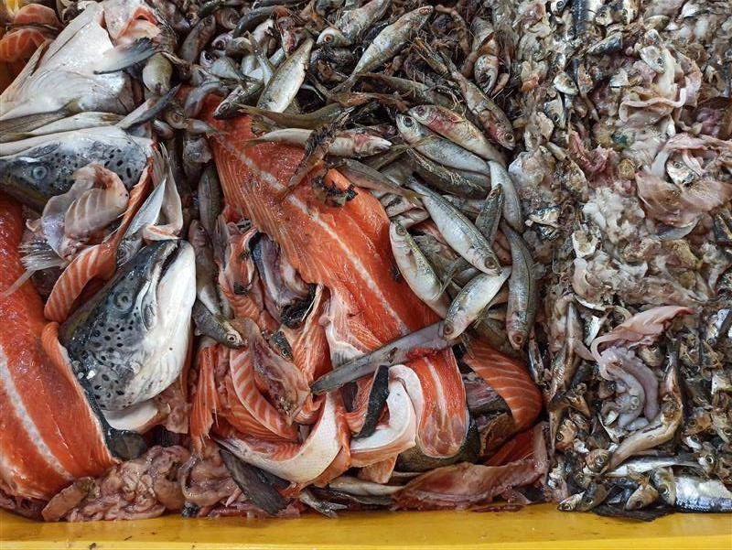
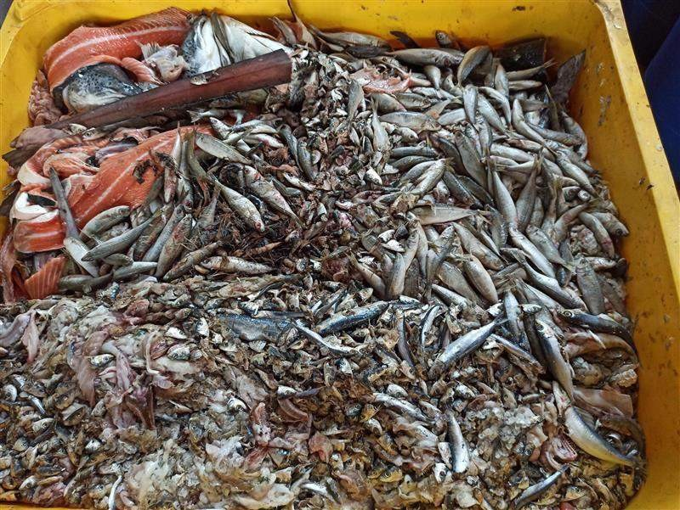

Indicative Raw Materials from Fish industry by-products

Slide 8
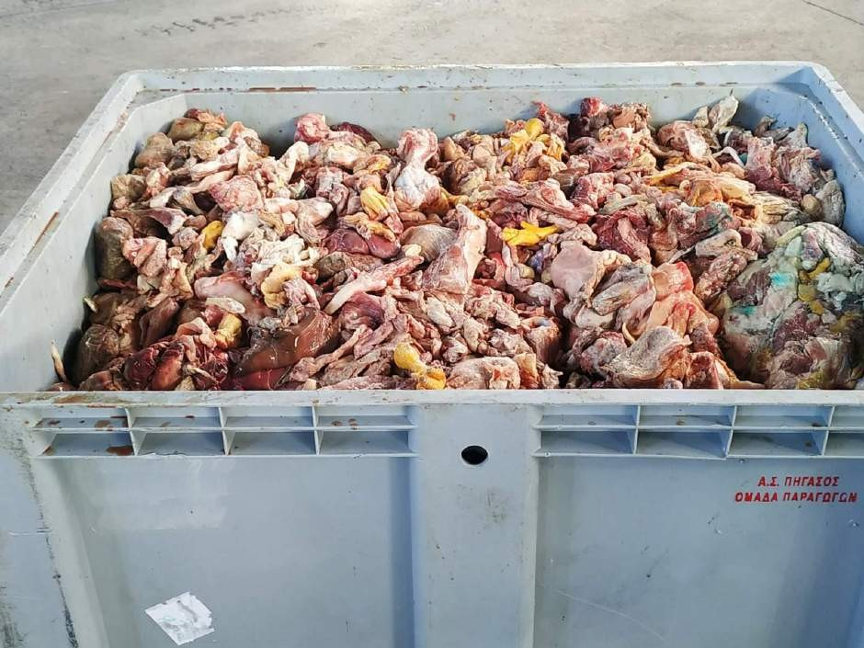
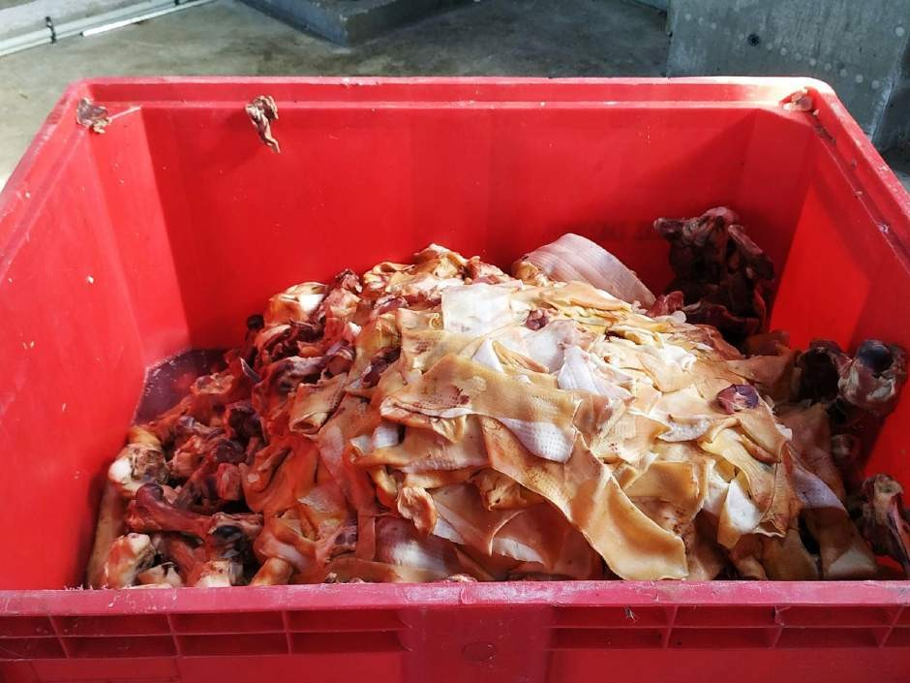

Indicative Raw Materials
from Meat industry and butcher shops by-products

Slide 9
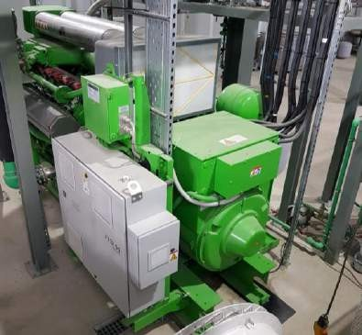
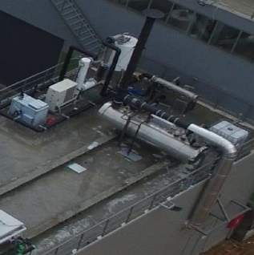
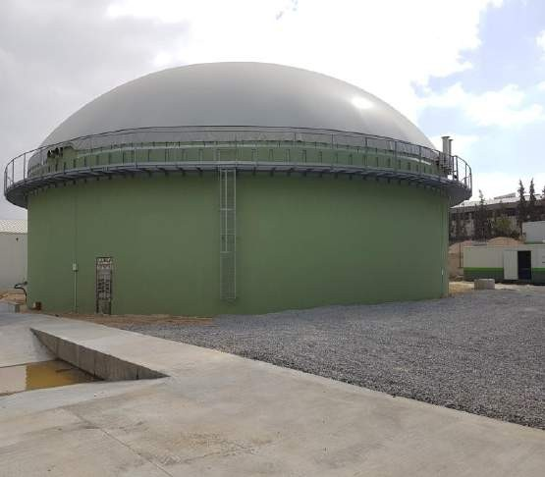
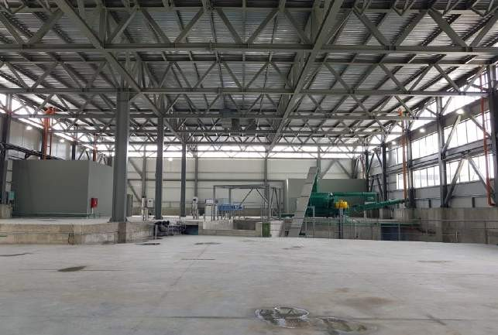
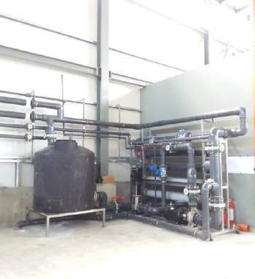


Facility Process Flow
ELECTRICITY
ELECTRICAL
GRID
FLARE
BIOGAS CLEANING
CHP
THERMAL ENERGY
Whey, Oil-mill residues, pig manure (liquid)
BIOGAS
DIGESTER
INTERNAL
CONSUMPTION
Man
sl
ure, organic
udge, pig
^{ure (solid)} PASTEURIZATIO
ghterhouse e, aquatic
mals, animal Crusher
rigin by-
roducts
ood, Fats MIXING TANK
left-overs, _{Crusher/}
ricultural
roducts Separator
man
N
Slau wast ani
o
DIGESTATE
STORAGE TANK
p
Liquid fraction
FAN SEPARATOR +
MFT + DECANTER
WWTP (MBBR-
MBR-UF-RO)
Bl
Solid fraction
Food ag p
FERTILIZER
18

Slide 10
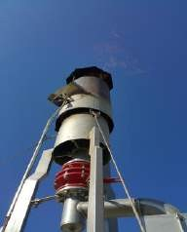
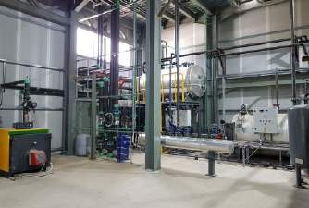
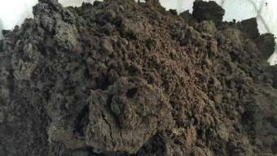
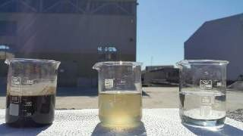

Products
Electricity
Heating (self consumption and local district heating)
Solid Residue (excellent compost)
Pure Water

Slide 11
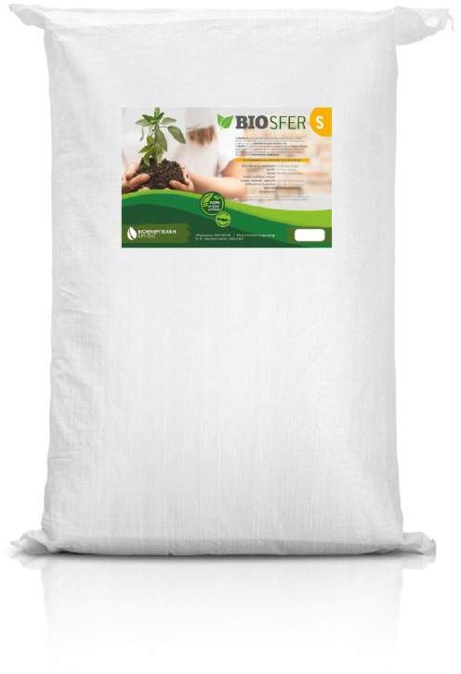
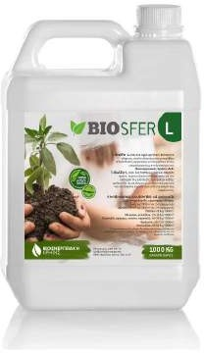
Organic Compost Liquid & Solid
of high added value
Products

Slide 12
Challenges - Innovations
Reception & management of incoming raw materials
WWTP (MBR –
MBBR – UF – RO)
liquid digestate management
Odor control
system - biofilter

Slide 13
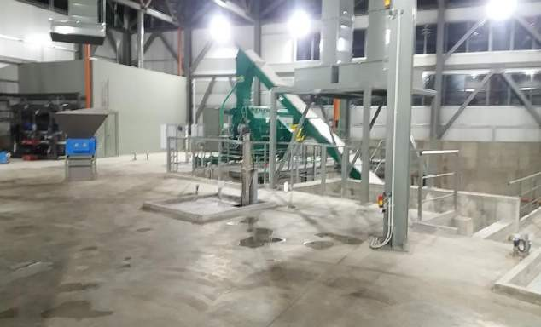

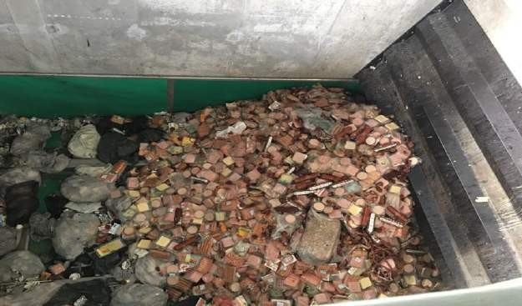
Challenges - Innovations
Reception & management of incoming raw materials
18

Slide 14
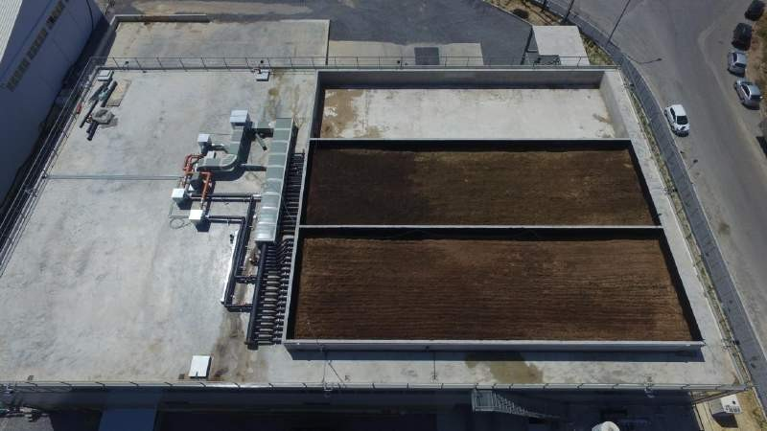
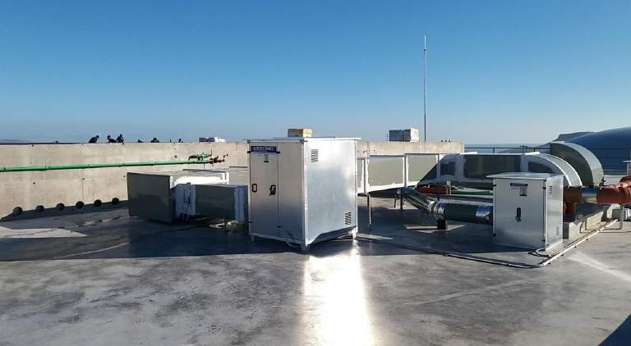
Challenges - Innovations
Odor control system - biofilter

Slide 15
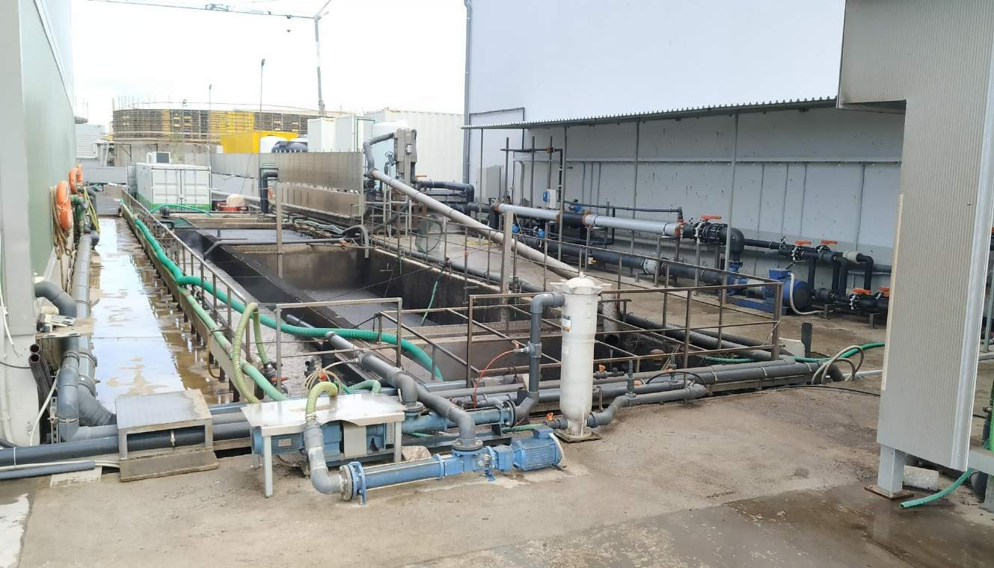
Challenges - Innovations
WWTP (MBR –
MBBR – UF – RO)
liquid digestate management
Installation of wastewater treatment plant (MBR & BioBoost)

Slide 16
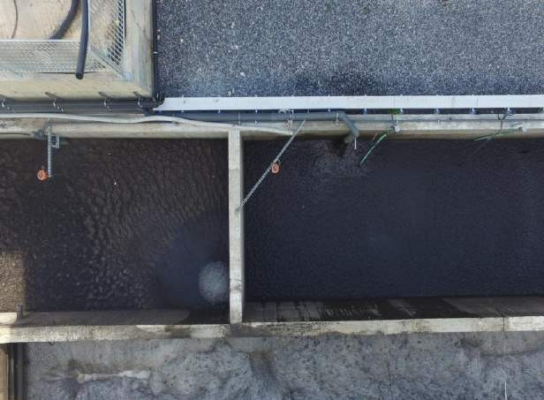
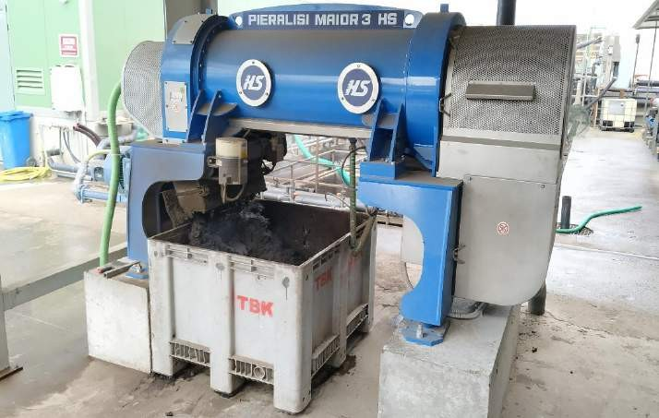

Challenges - Innovations
WWTP (MBR –
MBBR – UF – RO)
liquid digestate management
Installation of wastewater treatment plant
(MBR & BioBoost)
Decanter

Slide 17
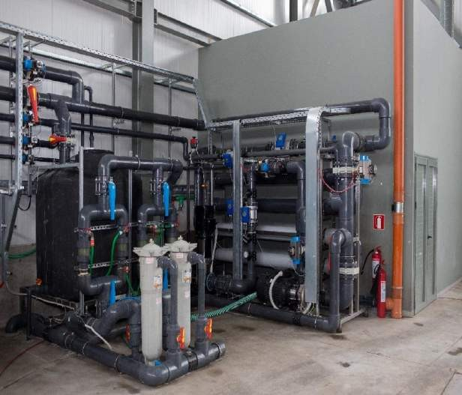
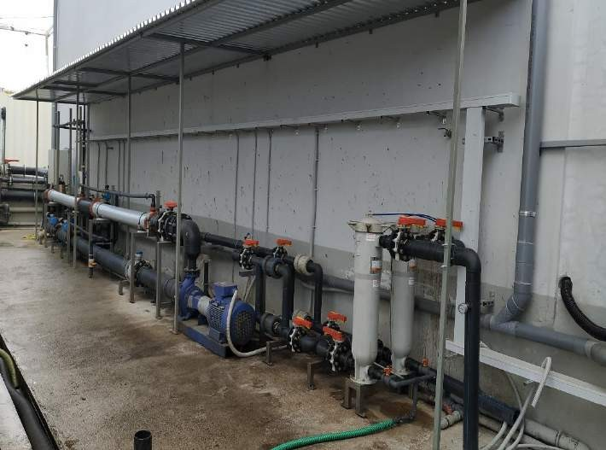

Challenges - Innovations
WWTP (MBR –
MBBR – UF – RO)
liquid digestate management
Installation of Ultrafiltration membranes (UF)
Double system

Slide 18

Challenges - Innovations
WWTP (MBR –
MBBR – UF – RO)
liquid digestate management
FINAL PRODUCT PURE WATER

Slide 19
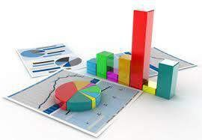
Statistics

Slide 20



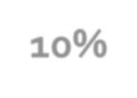


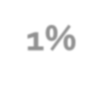
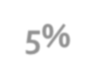


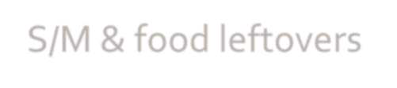
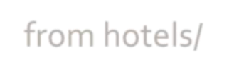

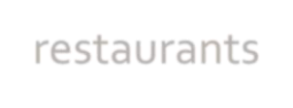
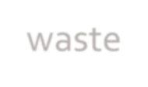
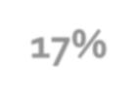
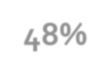
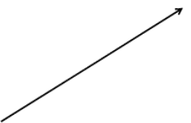

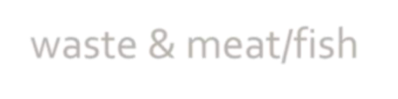


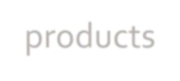



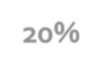


Raw Materials – type & quantity
Oils and Fats
10%
1%
5%
Expired food from S/M & food leftovers from hotels/ restaurants
Butcher shop waste
17%
2020
16.947 tn
48%
Slaughterhouse waste & meat/fish industry by- products
Poultry & pig manure
20%
Whey

Slide 21

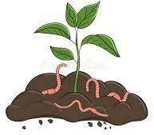
Companies Served – Circular Economy
80 companies & biowaste producers
18 organic compost clients

Slide 22


Total CO2 emission Savings
65.529.863 km
YEAR | SAVINGS
 | CO2 (tn/y) | TREES | CARS (km)
2017 | 1.033,32 | 28.106 | 7.301.876
2018 | 1.817,19 | 49.428 | 12.840.983
2019 | 2.213,09 | 60.196 | 15.638.578
2020 | 2.597,31 | 70.647 | 18.353.597
252.238
9.273,44 tn

Slide 23

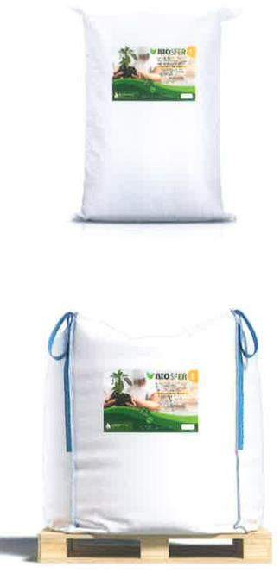
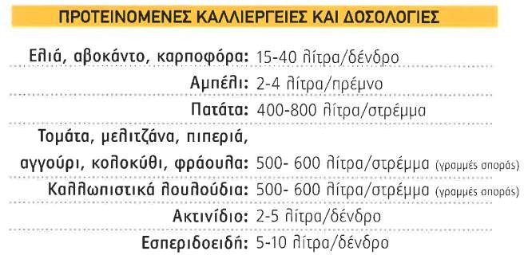
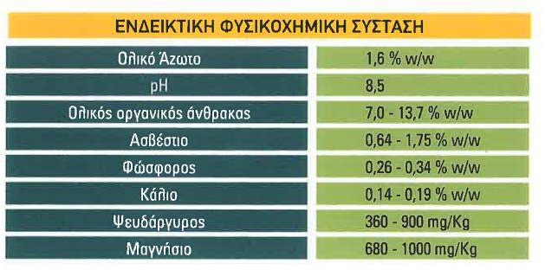

Organic Compost

Slide 24
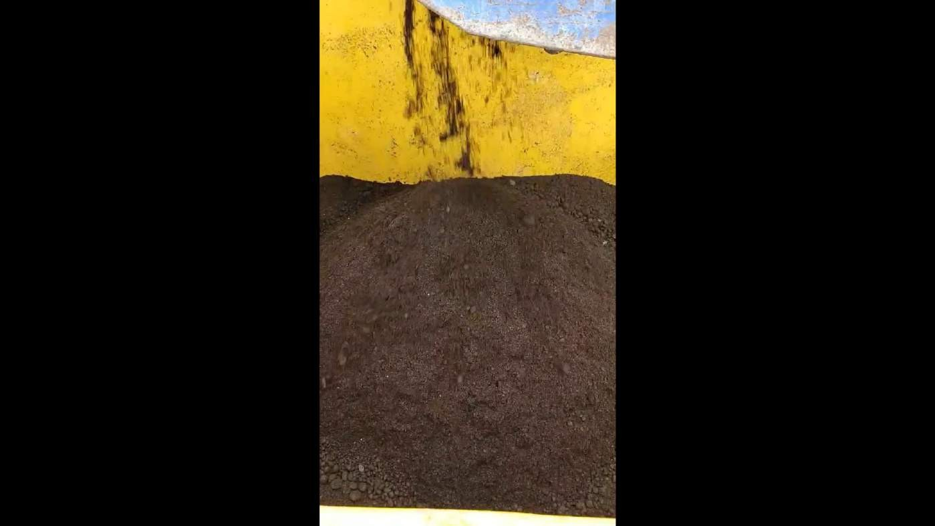

Organic Compost – Drying Process

Slide 25

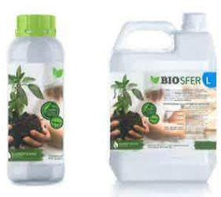
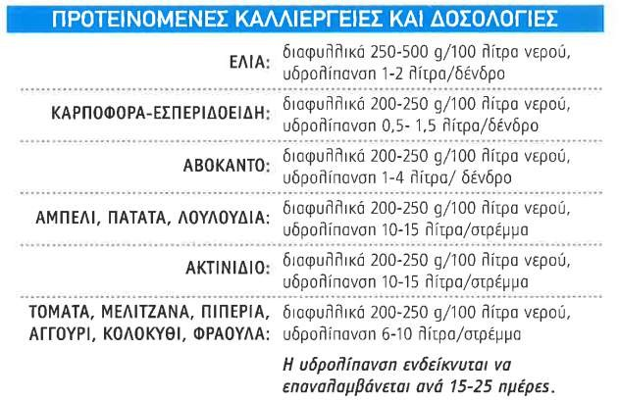
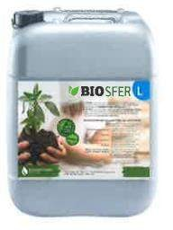
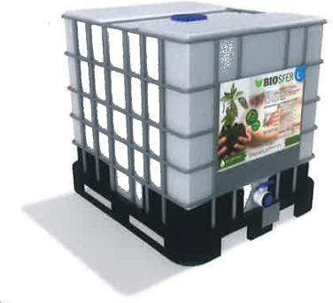

Organic Liquid Soil Conditioner

Slide 26

Biogas
to Biofuel

Slide 27




Biogas to Biomethane
12/4/2022
SYCHEM GROUP OF COMPANIES

Slide 28

“Production procedure”
Video

Slide 29


12/4/2022
SYCHEM GROUP OF COMPANIES

Slide 30

Awards and Distinctions

Slide 31




2019 - Two prestigious international awards for the innovative Biogas Plant in Crete - AD and Biogas Industry Awards, Birmingham, UK
“Most Circular City Award”
“Best Biogas Plant (on-farm, food waste or sewage) equal to or below 1 MWe- equivalent”

Slide 32


International Publications in press for TECHNICAL BIOENERGY CRETE Project.
Bioenergy International, Digital Biogas Special 1, 2020

Slide 33

BIOENERGY CRETE
www.bioenergycrete.gr info@bioenergycrete.gr

