Slide 1

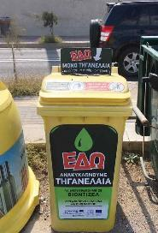
RETHYMNO MUNICIPALITY
Smart collection of Used Cooking Oil (UCO)
Nikoleta Golfinopoulou, Head of Waste Management & Urban Environment Dpt, Rethymno Municipality
Stavroula Tournaki, Renewable & Sustainable Energy System Lab, Technical University of Crete

Slide 2
Problem addressed
UCO disposal and environmental concerns
UCOs: oils & fats from food industry, restaurants & households (European Waste Catalogue - code 20 01 25)
Most common households’ UCOs practice is: throw it in the sewage system
clogging the sewage system
cause serius malfunctions in the filters & oil/water separators
increase wastewater treatment cost
Recycling UCO to biodiesel is a sustainable alternative for the exploitation of a problematic waste
it does not compete other edible feedstock
it does not produce land use change effects

Slide 3
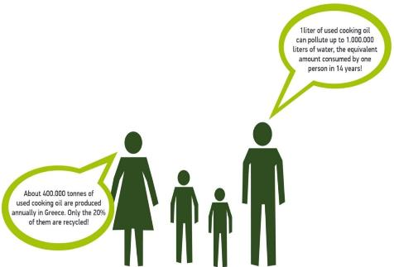

Slide 4
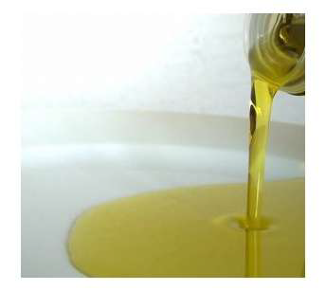
The used cooking oil:
⇒We do NOT throw it in the sewer because it clogs it
⇒We do NOT throw it in the trash because it makes it flammable

Slide 5
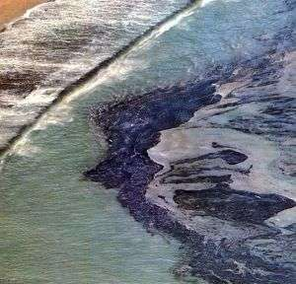

The used cooking oil:
⇒We do NOT throw it in the sea because it repels plankton and fish
⇒We do NOT throw it in the bush because it contaminates the aquifer horizon

Slide 6

The used cooking oil:
⇒We do NOT eat it because it damage our health
⇒We do NOT feed it to our animals because it will eventually end up in our dish
⇒We do NOT make soap because it can damage our skin

Slide 7

Why do we recycle UCO?

Slide 8
Why do we recycle UCO?
To protect the already congested environment.
If we do not recycle used cooking oils they will end up in drains or Landfill and then on the aquifer.
Large percentage of problems (blockage etc) that we see in the sewers is due to used edible oils.

Slide 9
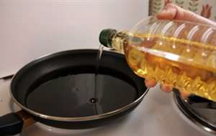
Which oils do we recycle?
Any oil we use for cooking and frying.
Motor oils (mineral lubricants) are recycled by different process and should not be mixed with cooking oils

Slide 10

Recycling Used Cooking Oil - Environmental Benefits
1. Eliminated used cooking oils permanently from food chain. Avoid their reuse after the illicit processing as edible (a processing that is prohibited by relevant legislation) and their indirect introduction to the food chain through animal’s food (which is also prohibited)

Slide 11

Recycling Used Cooking Oil - Environmental Benefits
2. Solve the big problems caused from these oils, as liquid waste when they end up in the sewer system

Slide 12

Recycling Used Cooking Oil - Environmental Benefits
3. Used cooking oils (frying oils) are an alternative raw material for biodiesel production

Slide 13
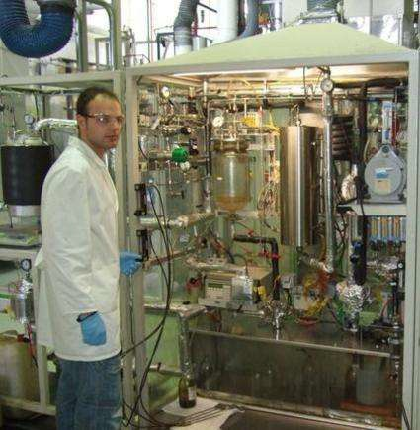
Recycling Used Cooking Oil - Environmental Benefits
4. Biodiesel has similar physical properties with diesel so it can be used as diesel’s substitute or it can be mixed with diesel

Slide 14
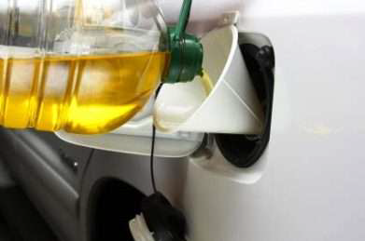
Recycling Used Cooking Oil - Environmental Benefits
5. The advantages of biodiesel are multiple: biodegradable, non-toxic. It has almost zero sulfur content, increased lubrication, low emitted soot and it contains carbon dioxide (due to its renewable nature) decreasing the greenhouse effect

Slide 15
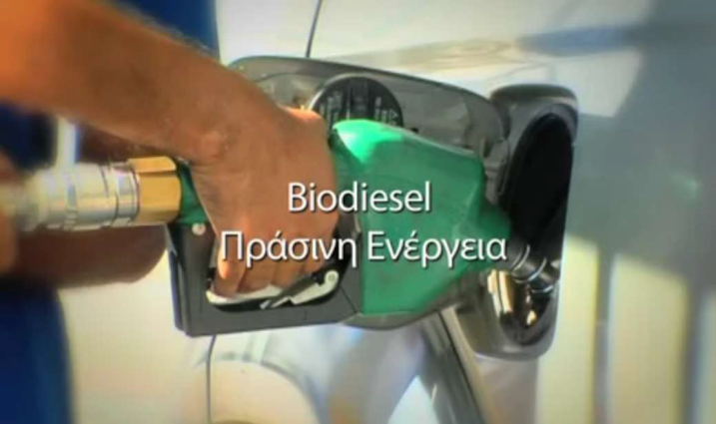
Recycling Used Cooking Oil - Environmental Benefits
6. Emissions of biodiesel are 40-50% lower than those of diesel with the exception of nitrogen oxide emissions

Slide 16

Recycling Used Cooking Oil - Environmental Benefits
7. We do not pollute the aquifer
8. We reduce the volume of waste that ends up in landfills
9. We recycle, even using the most appropriate method of sorting at source
10. We save natural resources
11. We contribute to green growth by creating new jobs
12. We actively participate in the global effort made for reversal of climate change

Slide 17
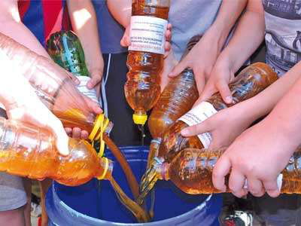
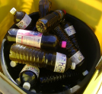
COLLECTION PROCEDURE
We collect the oil in plastic bottles and empty them in special recycling bins

Slide 18

Households’ UCO Smart Collection in Rethymno increase UCO recycling rate & enhance safe disposal by expanding & optimising the collection network with smart sensors and web-based monitoring

Slide 19


Implementation - The project team
(Demonstration project in the frame of Interreg
MED COMPOSE)
  Assess EU experience and available solutions
  Design/develop the smart collection scheme
  Procurement of equipment; web platform functionalities
  UCO collection bins labeling
  Monitor and testing the smart network operation
  Communication and educational activities
  Test the UCO transformation to biodiesel; quality control
RESeL - TUC
Project Initiator-Leader
Rethymno Municipality
Associate partner
  Siting of the UCO bins; installation on site
  Call for tender; contracting licensed UCO collector
  Maintenance of the UCO collection network
  Dissemination activities
Local Action Group
  Assessment of needs and potential solutions
  Support the decision making; to overcome operational barriers and to promote the system use
Private actors
UCO registered collector: Collection of UCOs
Equipment provider: Sensors’ & web platform development

Slide 20
Implementation
Step 1- Planning & considerations
UCO ‘public collection points system’ considerations
Incidents of UCO theft, due to rising UCO price
Large variations in the UCO produced per household:
  Difficulty for the UCO collector to predict the fill level of the UCO bins
  UCO collection routes are in most cases take place regardless the fill level of the bins
Risk of UCO contamination with other substances, especially when collected in bulk
40 different systems studied

Slide 21
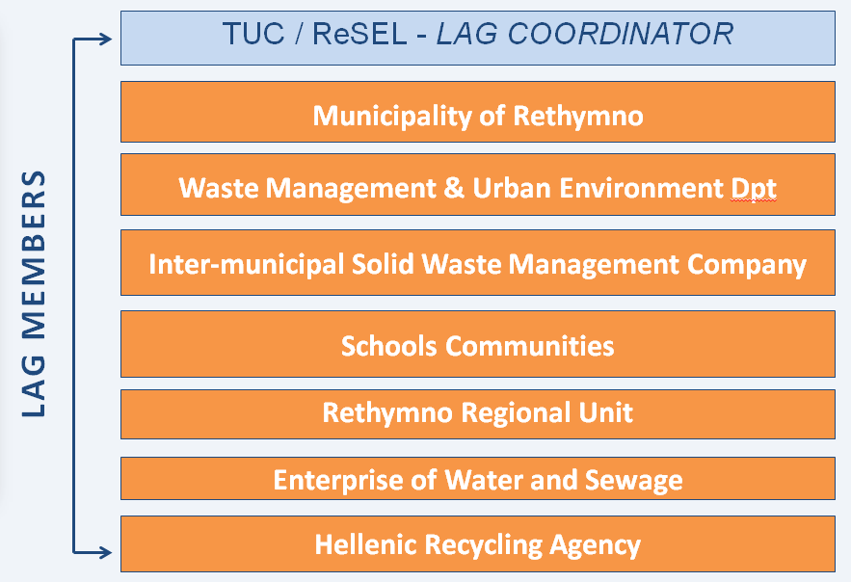
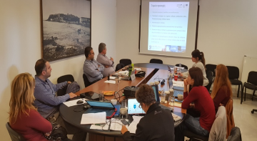
Implementation
Step 2- Stakeholders’ engagement
Local Action Group (LAG) Creation

Slide 22
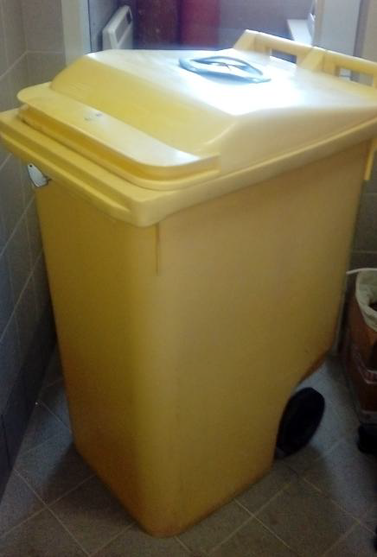
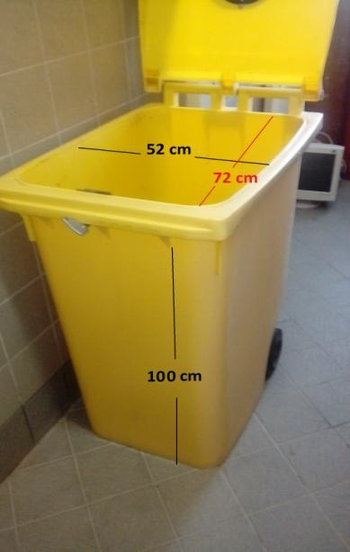
Implementation
Step 3- Design of the smart UCO bin
Smart UCO collection system – recycling

Slide 23
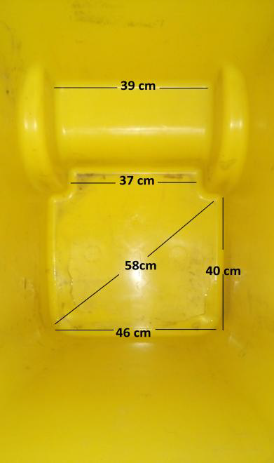
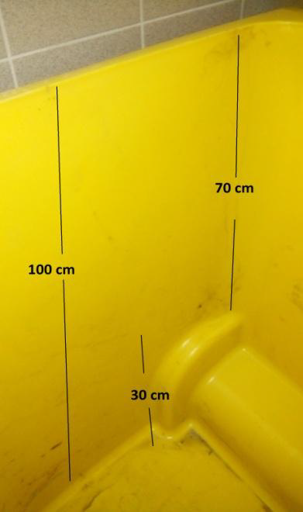
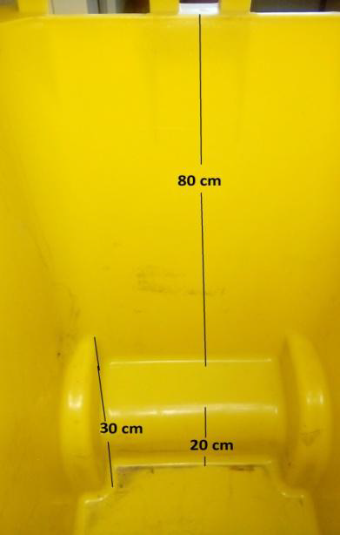
Implementation
Step 3- Design of the smart UCO bin
Smart UCO collection system – recycling

Slide 24
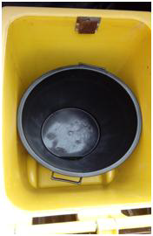
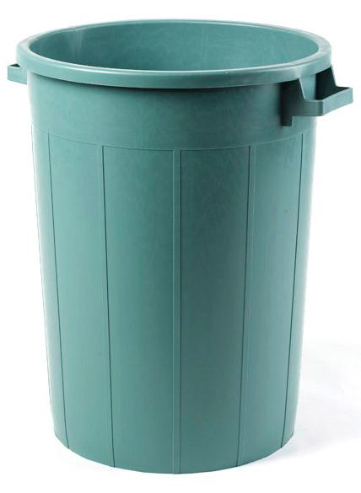
Implementation
Step 3- Design of the smart UCO bin
Smart UCO collection system – recycling
INNER BIN: Capacity 120l, height 75 cm, diameter 54 cm, with handles 60cm

Slide 25

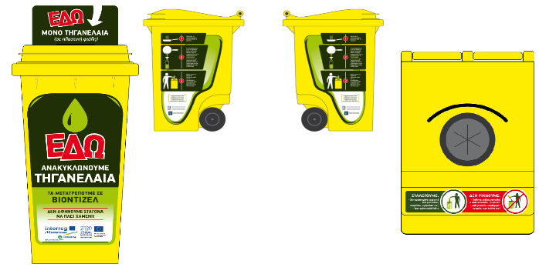
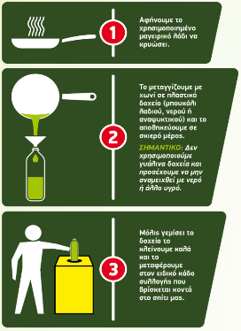
Implementation
Step 3- Design of the smart UCO bin
Smart UCO collection system – recycling
Bottled UCO vs bulk collection minimize:
risk of contamination with other wastes
aesthetic degradation of bin & surroundings

Slide 26
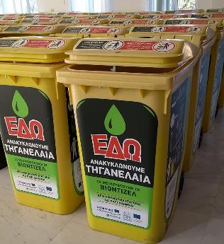
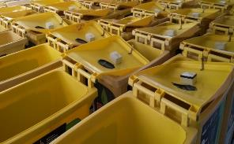
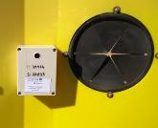

Implementation
Step 4- Smart sensors’ installation
Data recorded by the sensors are transferred wirelessly through GSM, in real time
A software application allows:
monitoring of a bin’s fill level 0 - 100%
tracking its location in the city (GPS) with 2.5 m accuracy
Alert message:
bin non authorised movement
to selected fill rate
for unexpectedly temperature raise

Slide 27

Implementation
Step 5- Siting of the smart UCO bins

Slide 28
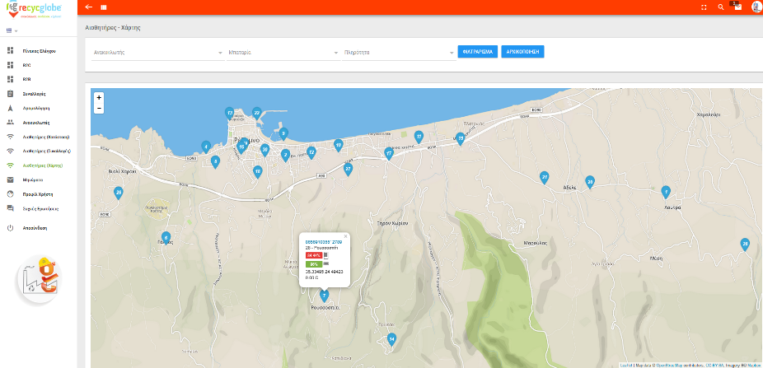
Implementation
Step 6- Monitoring & UCO collection
Smart UCO bins locations monitored through the web platform

Slide 29
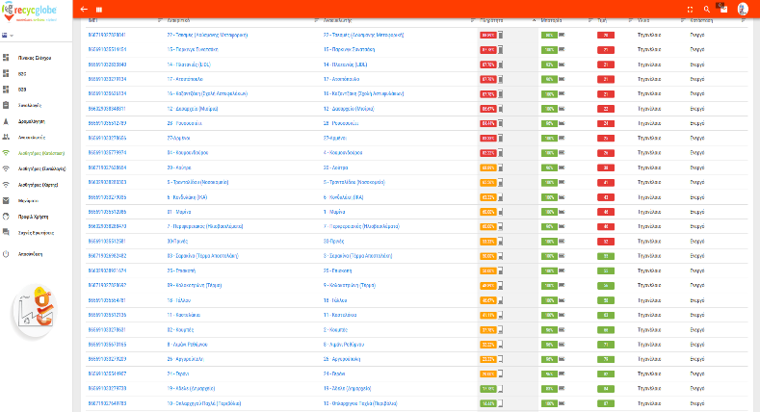
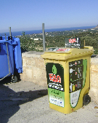
Implementation
Step 6- Monitoring & UCO collection
Smart UCO bins monitored through the web platform

Slide 30
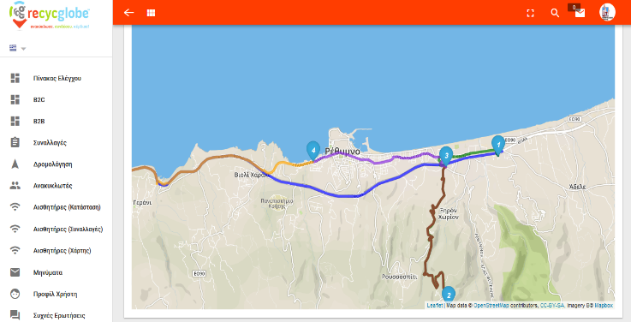
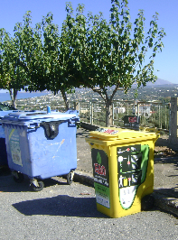
Implementation
Step 6- Monitoring & UCO collection
UCO collector’s route optimization based on the full - level

Slide 31
Implementation
UCOs collected per month (2018 - 2019)

Slide 32
Implementation
UCOs collected per month (2020)
Notes:
ΣΥΝΟΛΟ 866 ΛΙΤΡΑ, 590 € (0,55€/ΛΙΤΡΟ)

Slide 33
Implementation
UCO collected per smart bin
Notes:
ΣΥΝΟΛΟ 866 ΛΙΤΡΑ, 590 € (0,55€/ΛΙΤΡΟ)

Slide 34
Evidence of success
Outputs
A fully operational smart UCO collection system.
Informational and educational materials to promote the benefits of UCO recycling.
Rollout plan for the operation and maintenance of the system operation after the project’s end.
Licensed UCO Collector assigned through open call for tender
UCO to biodiesel transformation tested
Notes:
ΣΥΝΟΛΟ 866 ΛΙΤΡΑ, 590 € (0,55€/ΛΙΤΡΟ)

Slide 35
Evidence of success
30 bins allocated in selected sites outdoor - 20 bins to be installed at schools
approximately 3,500 lt of UCOs collected so far
small scale biodiesel unit producing biodiesel from UCOs
40,000 people reached by the awareness-raising activities
ensured sustainability due to public-private sector collaboration
potential expansion to UCOs and/or other wastes
Notes:
ΣΥΝΟΛΟ 866 ΛΙΤΡΑ, 590 € (0,55€/ΛΙΤΡΟ)

Slide 36
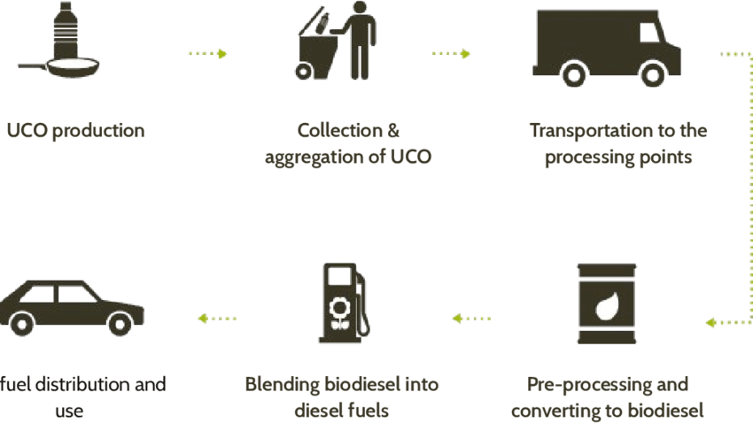
  Key success factors
Support from local stakeholders: necessity to accomplish the project
Schools communities engagement: must for behavioral change; recycling rate increase
Strategic siting of bins: must be carefully designed
Educate the citizens on the proper disposal of UCO and the separation of waste
Notes:
ΣΥΝΟΛΟ 866 ΛΙΤΡΑ, 590 € (0,55€/ΛΙΤΡΟ)

Slide 37
  Lessons learned
Municipalities usually cannot fund the maintenance of a UCO to biodiesel system, this should be “self-financed” primarily by the UCO collected volume
When a transformation plant is not in proximity, the operation of the whole cycle involves high costs making the process less or –in some cases- not sustainable
The UCO collection scheme can be also extended to other types of waste within Rethymno Municipality and of course in other Municipalities, offering several environmental as well as financial benefits
Notes:
ΣΥΝΟΛΟ 866 ΛΙΤΡΑ, 590 € (0,55€/ΛΙΤΡΟ)

Slide 38

Thank you!!!
Contact us:
golfinopoulou@rethymno.gr
stavroula.tournaki@enveng.tuc.gr

