Slide 1
Τίτλος: Food for Feed: An Innovative Process for Transforming Hotels’ Food Wastes into Animal Feed (LIFE-F4F) Καινοτόμο Πρόγραμμα Αξιοποίησης Τροφικών Υπολειμμάτων Ξενοδοχείων
LIFE15 ENV/GR/257
Kalliopi Bormpoudaki
Chemical Engineer, MSc
Association for the Solid Waste Management in Crete, Greece (EΣΔAK)
Ηράκλειο 8/10/2021

Slide 2
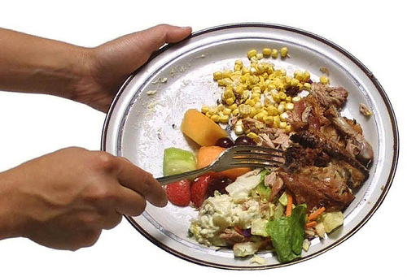
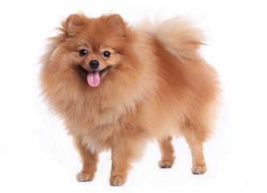
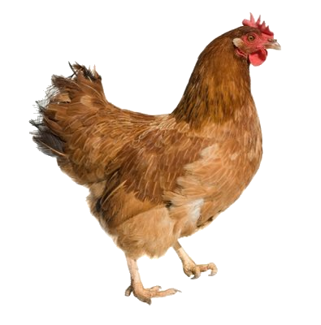
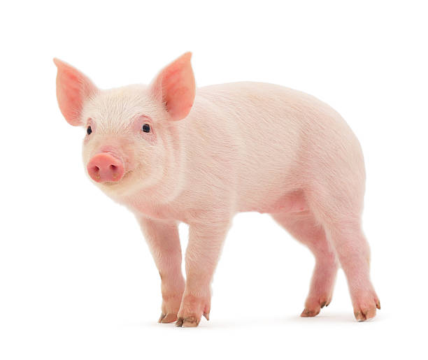
The Life Project: Στόχος
To evaluate an innovative, simple technology that allows the safe transformation of source separated food wastes into animal feed by the use of an
altered solar drying
process.

Slide 3
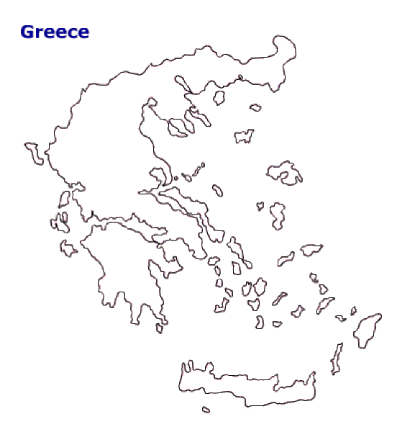
The Life Project
Location: Iraklion, Crete, Greece
Budget info: 2.580.619,00 €%
60% EC co-funding
Duration: 01/09/16 - 30/11/2021
IMPLEMENTORS:
Coordinator: Association of Solid Waste Management of Crete (ESDAK)
Hellenic Mediterranean University (HMU)
Harokopio University of Athens (HUA)
Agricultural University of Athens (AUA)
Freie Universität Berlin (FUB)

Slide 4
The Life Project: Actions
Actions B1, B2, B3, B6 & C2
Design, operate and evaluate a separated collection scheme for hotels’ food wastes
Action B4, B5 & B6
Action B6 & C2
Evaluate the environmental, marketing and economic aspects of the process in a full size application
Evaluate the quality of the produced feed, determine its commercial value, the possible need for further processing and the customer acceptability
Construction and operation of an automated solar drying/ pasteurizing unit
Actions Β7
Evaluate the potential role of such a system in EU policies
Action C
Action D
Dissemination activities
Monitoring, Evaluation of project’s progress and performance
Action E
Project management and monitoring of projects objectives

Slide 5
Optimum collection routes
Start | End | distance | speed | duration | speed1 | dur1 | speed2 | dur2
Base | Siganos Executive Food Events Catering | 1.59 | 9.60 | 9.93 | 9.60 | 9.93 | 9.60 | 9.93
Siganos Executive Food Events Catering | AQUILA ATLANTIS HOTEL | 5.73 | 18.28 | 18.80 | 18.28 | 18.80 | 15.00 | 22.90
AQUILA ATLANTIS HOTEL | Galaxy Hotel Heraklion | 1.40 | 11.18 | 7.51 | 11.18 | 7.51 | 11.18 | 7.51
Galaxy Hotel Heraklion | Apollonia Beach Hotel | 12.13 | 46.99 | 15.50 | 30.00 | 24.27 | 15.00 | 48.54
Apollonia Beach Hotel | Creta Maris Beach Resort | 37.35 | 59.02 | 37.97 | 30.00 | 74.71 | 15.00 | 149.41
Creta Maris Beach Resort | Base | 23.19 | 38.31 | 36.32 | 30.00 | 46.38 | 15.00 | 92.76
Summary: | min/Km/Km/h | 81.39 | 38.75 | 126.02 | 30.00 | 162.78 | 15.00 | 325.57

Slide 6
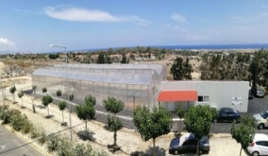
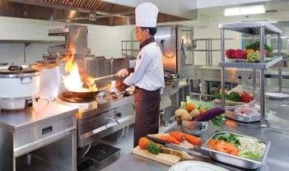
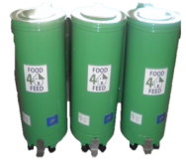
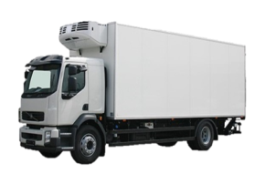
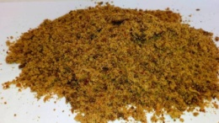
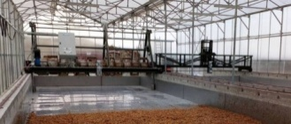
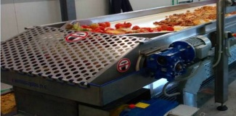
Flow chart…
F4F pilot unit
Food waste generation in hotels
Waste collection
refrigerator track
Collection bins
Produced dried feed
Solar drying
Hand sorting-schredding
20% residues

Slide 7
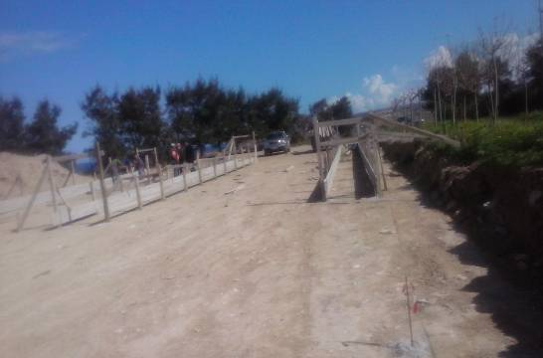
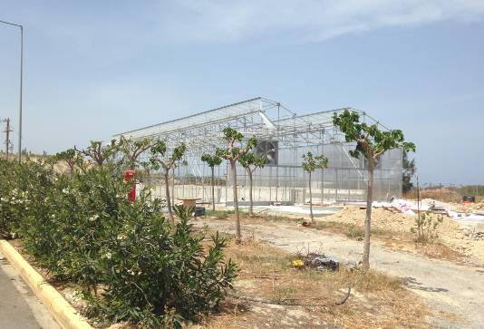
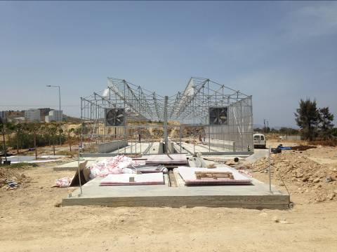
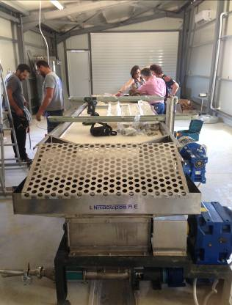
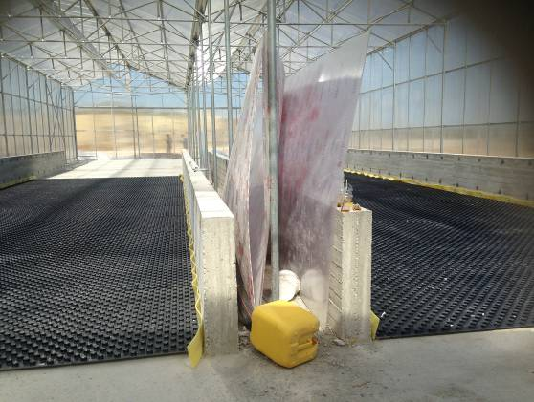
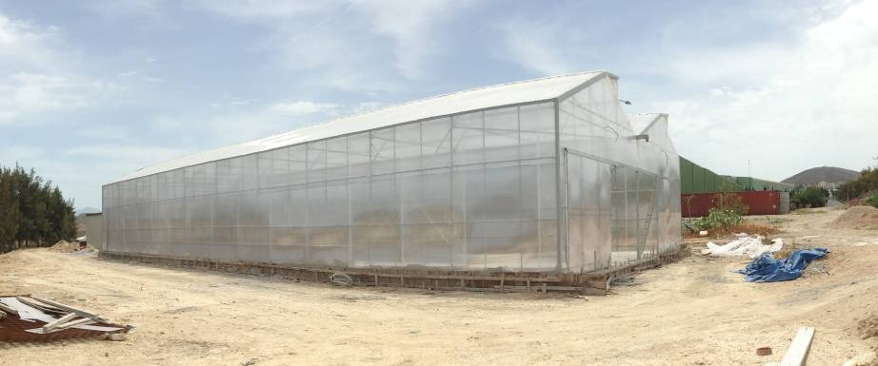
Under construction…

Slide 8
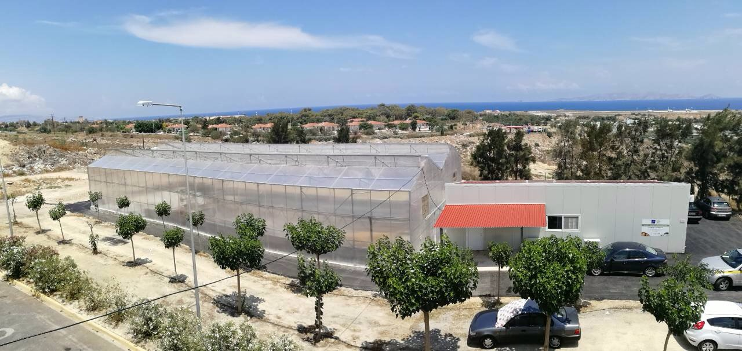
Pilot UnitF4F …

Slide 9
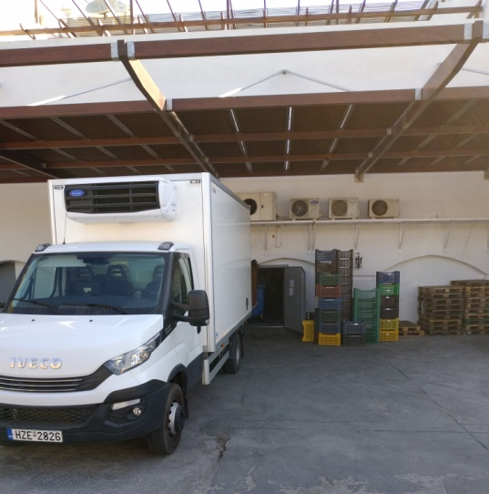
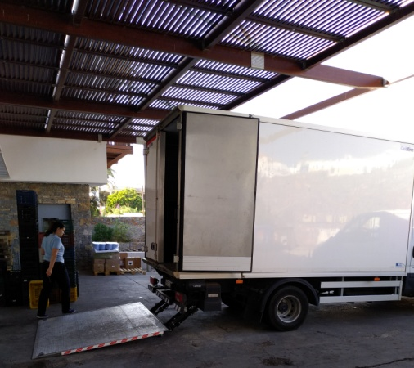
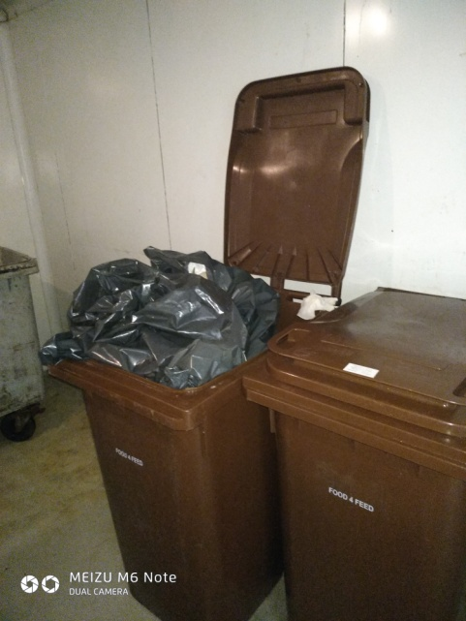
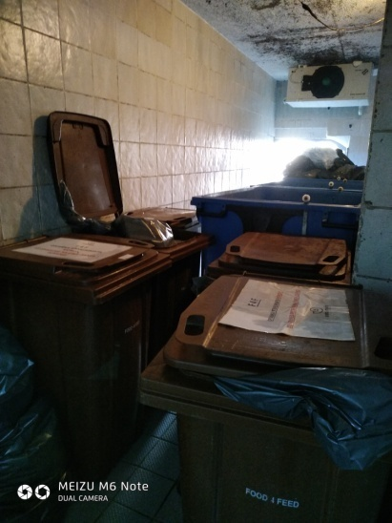
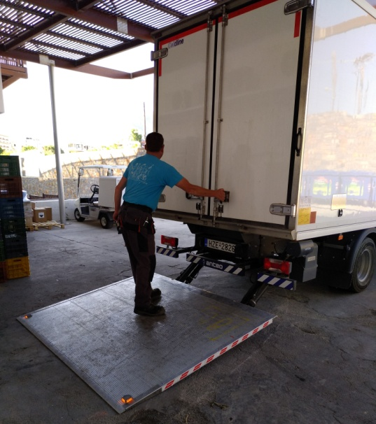
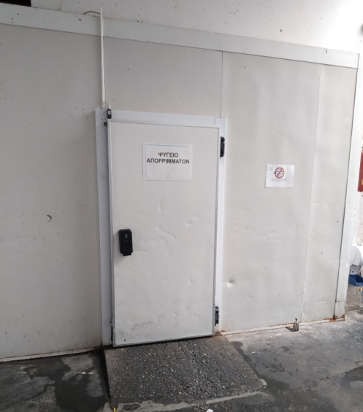
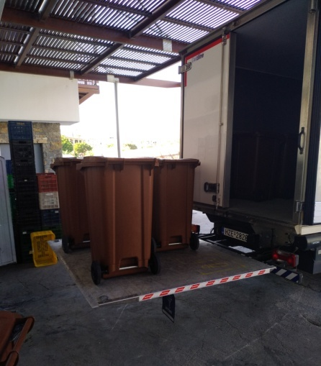
The Pilot Unit – Food waste collection at the hotels

Slide 10
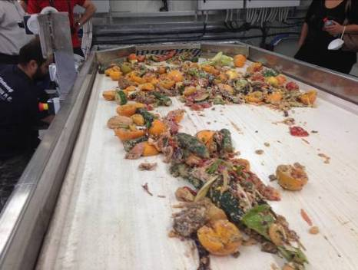
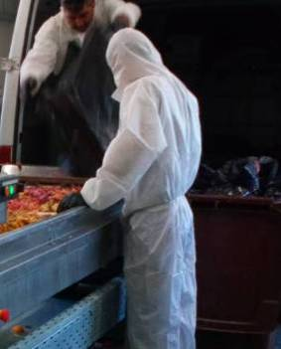
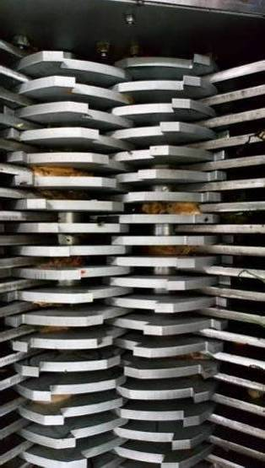
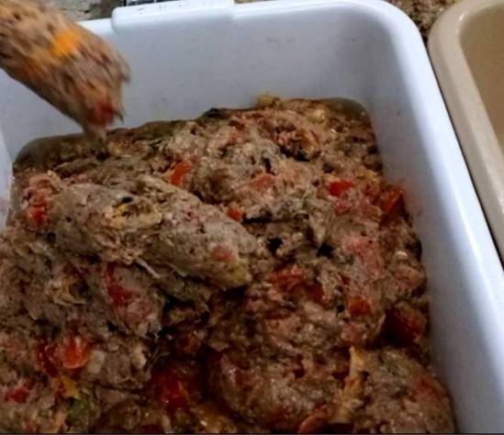
The Pilot Unit – Hand sorting in the pretreatment unit

Slide 11
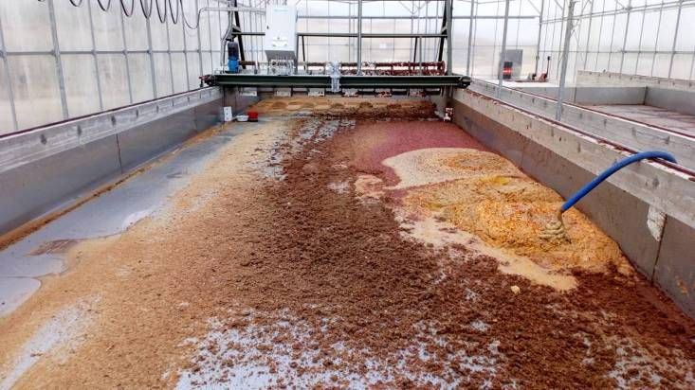
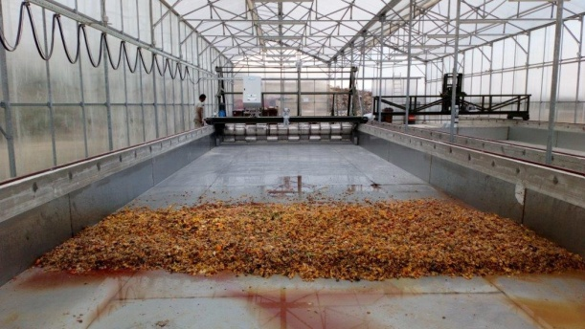
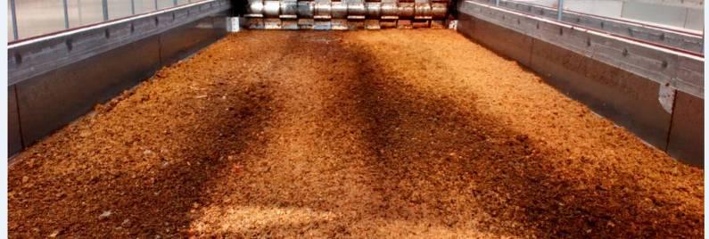
The Pilot Unit – Solar drying of the shredded food waste

Slide 12
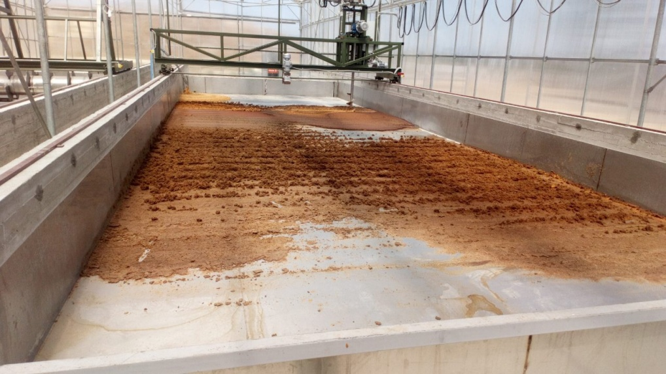
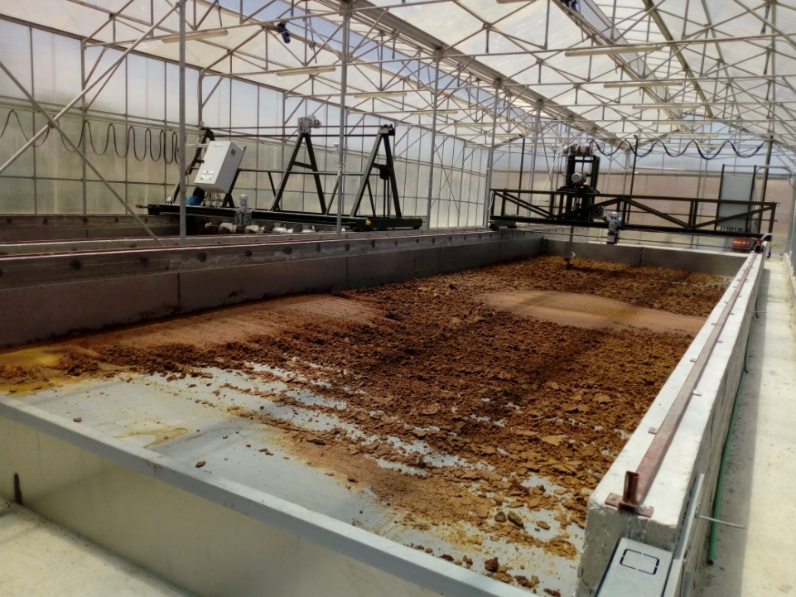
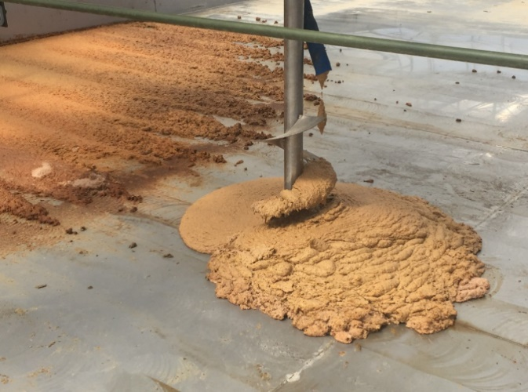
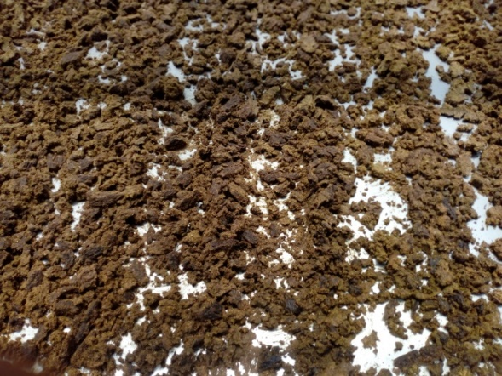
The Pilot Unit – Solar drying of the shredded food waste

Slide 13
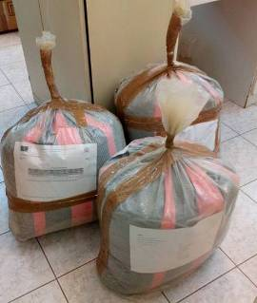
The Pilot Unit – The final product
Samples send to partners for trials
Table 1. Drying moisture loss duration in the pilot unit (35-40ºC)
Drying (days) | 1st day 17/09/2018 | 2nd day 18/09/2018 | 4th day 20/09/2018 | 8th day 24/09/2018
Moisture (%) | 68% | 64% | 40% | 12-15%

Slide 14
The Pilot Unit – The final product
Moisture 75%→ 12%
Average drying rate: 6-8 days
Total food waste collected during 3 operational periods:450tn
Total dried product produced: 150tn

Slide 15
The Pilot Unit – Operational data
1st period
Initiation
20/06/2018-31/10/2018
2nd period
Full scale operation
03/06/2019-31/10/2019
3rd period
Opt. scale operation
22/6/2020-14/12/2020
Collection: 7d/week, 175d
4 collection points
Total food waste collected:
115 tn
Avg daily collected food waste: 0,66 tn/d
Solar drying ret. time:
8-12 days
Collection:6d/week, 124d
5 collection points
Total food waste collected:
135 tn
Max daily collected food waste: ≈2 tn/d
Avg daily collected food waste: 1,09 tn/d
Solar drying retention time:
6-10 days
Collection: 6d/week, 150d
3-4 collection points
Total food waste collected: 200 tn
Avg daily food waste collected: 1,33 tn/d
Solar drying retention time:
6-8 days

Slide 16
Total collected waste during 3 operational periods
The Pilot Unit – Collection data
Total produced F4F dry product: more than 150tn
Total collected food waste quantity for the 3 operational periods (May – October) : more than 500tn DERIVED FROM LANDFILLING

Slide 17
ACTION B.4, B.5.: Evaluating the Produced Feed for Pigs and Poultry Husbandry and as Pet Food
Main objective:
To determine the quality of the produced feed, through a range of analysis and trials.
To evaluate the inclusion of the F4F product as an ingredient in pet food with regard to feed hygiene, feed acceptance, nutrient digestibility, animal welfare and public acceptance.

Slide 18
ACTION B.6: Products’ Customer Survey, Technical Scale Up, Economical and Environmental Evaluation and Replicability and Transferability of the F4F Process
Actions’ main objective:
All actions that will help the implementation of the F4F process into a full scale unit, either in the general area of the pilot unit and the direct involvement of the project’s members or in other areas, through strong support of replicability and transferability actions

Slide 19
The Life Project
ACTION B.7.: Completing, Incorporating and
Evaluating the F4F Process as Part of the EU’s Wastes
Strategy and other Union Policies
Main objective:
Conducting a number of versatile activities for the evaluation of
the F4F potential as part of the:
Wastes Strategy of the EU
Other Union Policies
Resources Efficiency Roadmap

Slide 20
The Life Project
Website: https://life-f4f.gr, https://esdak.gr
LifeF4FCrete

